Slide 1
Adopted Blended Learning
Moumi Sarkar

Slide 2
What we will learn today...
Four pillars of flipped learning
Tips before you start
How to design a Flipped classroom
Challenges and solutions of Flipped Approach
How to make a Flipped Lesson plan

Slide 3
First let´s talk about Finnish Education system

Slide 4
Education for all
The development of the whole education system takes time. During the first years of the 20th century, only a third of rural children went to school.
The 1921 act on compulsory education started the path towards a modern education system based on the philosophy of education for all.
Today education from pre-primary to higher education is free of charge for Finns and citizens from EU/ETA countries. Early childhood education and care is subsidized.

Slide 5
The Finnish education system today
Secondary education
16-19-year-olds
Matriculation examination in general upper secondary schools
Tertiary education
Appr. 3+2 years
Bachelor’s and Master’s degrees at Universities
Doctoral degrees and licentiate degrees in Universities
Basic education
0-5-year-olds
Early childhood education and care
6-year-olds
Compulsory pre-primary education
7–16-year-olds
Basic education in comprehensive schools
16-19-year-olds
Vocational qualifications in vocational institutions
Appr. 3+2 years
Bachelor’s and Master’s degrees at Universities of Applied Sciences
Notes:
The Finnish education system today consists of early childhood education and care, one-year pre-primary education, nine-year basic education, upper secondary (general or vocational) and higher education.
Additionally, lifelong/continuous learning is emphasized and adult education is available at all levels of education and in non-formal education. It is no coincidence that in Finland enrolment in adult education ranks among the highest in the world together with other Nordic countries.

Slide 6
Characteristics of Finnish education
Schools are given a great deal of autonomy. The national core curriculum is localized and there is a high level of trust between the national and local school authorities.
Teachers are professionals of learning. They can for example decide how they teach and what learning materials and resources they use.
All children are entitled to special support. Pupils with minor or medium learning difficulties study in the same schools and classrooms as the others, but the schools are allocated additional resources.
Finnish children begin pre-primary education at the age of six, spend less time in the classroom and have less homework than kids in many other countries, but still have excellent learning outcomes.
Notes:
The average class size is around 20 pupils in primary and lower secondary education. At primary level, the average class in OECD countries has 21 students.

Slide 7
Teachers in Finland
Teachers are valued in Finnish society. Teaching is a popular profession and universities can select the most motivated and talented applicants.
Both class teachers and subject teachers are highly trained, and their research-based training includes pedagogical studies and teaching practice.
As a results, teachers are autonomous professionals with the expertise and ability to develop their own work. They are trusted, enjoy wide autonomy and have flexibility in their work.
Teachers also actively participate in developing education and educational solutions and learning materials.

Slide 8
A flipped classroom is a type of blended learning where students are introduced to content at home and practice working through it at school.

Slide 9
Four pillars of flipped learning

Slide 10
Flexible environment. learning in different ways and at different speeds and give learners choice in how they demonstrate evidence that they have mastered course content.
Learning culture.community that values the learning process in all its forms, including all the warts, with learners at the center rather than the instructor
Intentional Content. text, video, and online content that is tightly constructed with high educational quality and very little “fluff”
Professional educator. a number of difficult jobs for an INSTRUCTOR.

Slide 11
Tips before you think of Flipping your class
1. Start small. You don’t need to flip your entire class overnight. Start with just one lesson and then build from there.
2. Expect some resistance. Occasionally, students might be initially resistant to this approach, especially those who are used to teacher-centred learning environments. They may need time to see the value in this pedagogical approach.
3. Choose textbooks with digital tools. Many publishers now include online materials with their textbooks and these can be used to move some of the direct instruction out of the class.

Slide 12
How to design a Flipped Classroom

Slide 13
6 Easy Steps
Plan : Figure out which lesson in particular you want to flip. Outline the key learning outcomes and a lesson plan.
Record : Instead of teaching this lesson in-person, make a video. A screencast works. Make sure it contains all the key elements you’d mention in the classroom.
In Bergmann and Sams’ book (2012), they also pointed out that do not make a video just for the sake of making a video. Only do so when you feel these are appropriate and necessary. It all depends on the educational goal of your lesson. If making videos better facilitate your instructional goal, then go ahead.
Share: Send the video to your students. Make it engaging and clear. Explain that the video’s content will be fully discussed in class.
Change : Now that your students have viewed your lesson, they’re prepared to actually go more in-depth than ever before.
Group : An effective way to discuss the topic is to separate into groups where students are given a task to perform. Write a poem, a play, make a video, etc.
Regroup : Get the class back together to share the individual group’s work with everyone. Ask questions, dive deeper than ever before.
After the six steps, Review, Revise, and Repeat!

Slide 15
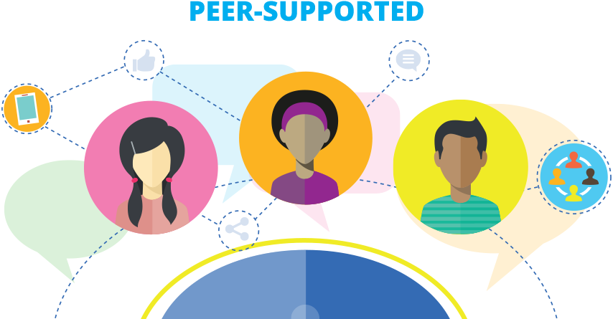
The students engage in in-class learning activities
It should involve peer instruction, collaboration, and interactions between the students and the instructor.
The best learning activities are also ones that students find challenging but achievable

Slide 16
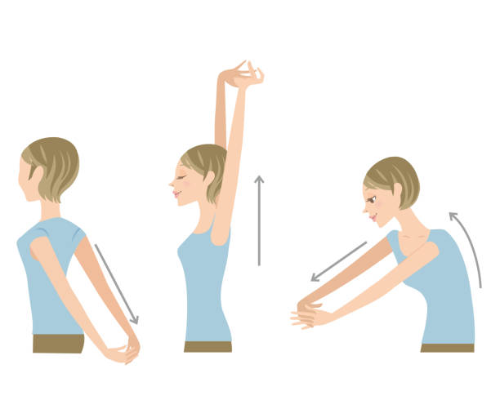
Tea break...

Slide 17
Challenges faced in making Flipped Classroom and solution tips
1. A lack of student discipline
For pupils who haven’t had any exposure to flipped learning, the less conventional setup can be a challenge. Students can struggle with self-discipline and may turn up to class without having absorbed the lesson; rendering the method pointless.
Teacher tip: When attempting to introduce the flipped classroom, it makes sense to start small, building student confidence with flipped tasks that let you practice and prepare for the bigger change. This softly-softly introduction gives pupils and teachers the chance to learn without becoming overwhelmed.

Slide 18
Challenges faced in making Flipped Classroom and solution tips
2. Lack of teaching resources
Content is vital to creating a successful flipped classroom. However, a new approach often requires fresh resources. With spare time the one thing few teachers have in excess, the thought of designing and creating new content can be enough to turn even the most enthusiastic of teachers off.
Teacher tip: With many educators now creating and sharing resources online, teacher-authored content designed to support flipped learning could provide the answer.
3. Old-fashioned classrooms
The layout of the traditional classrooms is another obstacle to flipped learning. Collaboration, communication and creativity, are at the heart of this method, but fostering these skills is almost impossible with pupils inactive in rows of desks all day.
Teacher tip: With a little imagination, savvy teachers can implement a more flexible classroom with the minimum amount of fuss, resource, and disruption; boosting student engagement and helping pupils to learn more effectively.

Slide 19
Challenges faced in making Flipped Classroom and solution tips
4. Lack of equipment
Video conferencing technologies, screen casting tools, and cloud-based platforms that let teachers create and deliver lessons all help to create the flipped classroom. However with poor quality, faulty, and out of date ICT equipment one the main reasons for teachers not using technology in the classroom, this can be a barrier to success.
Likewise, flipped learning requires students to have access to the internet and a computer or mobile device at home. However, this isn’t always the case, and it’s important not to create a barrier for those students who don’t have the necessary tech.
Teacher tip: To get around this, teachers should put a back-up plan in place for all students, showing them what to do if the internet goes down or they don’t have access. This could include identifying safe learning spaces with Wi-Fi, offering a borrowing library of computer devices, and providing learning content on USB drives

Slide 20
Can you think of any more challenges? Let’s discuss and find solutions.

Slide 21
An effective tool to make and upload video content for your students. You can add quizzers and edit your videos.

Slide 22
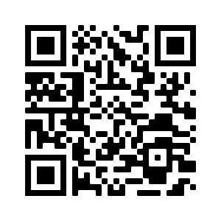
EDPUZZLE
Edpuzzle is an easy-to-use platform allowing you to engage every student, one video at a time.
More than 65% of students are visual learners, and +95% of your students watch YouTube regularly!
https://edpuzzle.com/media/5c9a664845a07b40ae2f66d8

Slide 23
BookWidgets allows you to make interactive lessons. BookWidgets provides strong digital templates of all kinds of interactive exercises. You just have to add your own content.
Choose between more than 40 different widgets or “exercises” to engage your students. Make your own adapted crossword riddles, video’s, jigsaw puzzles, web quests, quizzes, timelines and much more. Bonus: it does the grading for you. You can also put all the exercises together in a WebQuest. Here’s a flipped classroom example with a BookWidgets WebQuest.

Slide 24
BrainPOP creates animated resources that support teachers and engage students - in school, at home, and on mobile devices. Their content includes movies, quizzes, games, mobile apps, activity pages, and much more. The content covers hundreds of topics within Math, Science, Social Studies, English, Technology, Arts & Music, and Health.
Use their resources so students can watch and interact with their fun and clear videos at home. BrainPOP allows students to take some actions after seeing the explainer video, such as “write about it”, “draw about it”, “play a game” and much more.

Slide 25
TED-Ed
Browse hundreds of TED-Ed Animations and TED Talks - designed to spark the curiosity of your learners. Find thousands of other video-based lessons organized by the subjects you teach.
https://www.youtube.com/watch?v=JQDgE_eJGTM

Slide 26
Let´s practice

